Slide 1
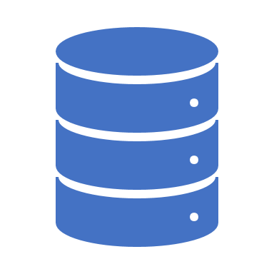

Data in Azure
Jasmine Greenaway
June 17th, 2020
Princeton University
aka.ms/princeton-azure/dataintro​

Slide 2

Why Data? Why Data in Azure?
Data can be a lot of work to maintain
The cloud can help you focus on your data
Data in the cloud can manage:
Backup, security, recovery, load balancing, encryption
Bring your dataset, use your tools:
Multiple ways to seamlessly migrate to Azure
Many options for storing your data, including virtual machines
aka.ms/princeton-azure/dataintro​

Slide 3

The Azure Data Platform
Operational databases
Data lakes & analytics
Azure SQL Database
for relational data
Azure Data Lake
for processing and analytics on data of any size, shape, and speed
Azure Data Services
Azure Cosmos DB
for non-relational/NoSQL data
Azure Databricks
for big data analytics and AI solutions
Data warehouses
Azure databases for MySQL, PostgreSQL, and MariaDB
open source relational data
Azure Synapse Analytics
for complex queries across petabytes of data
Azure HDInsight
for open source analytics
Reason over any data, anywhere
Security and performance
Flexibility of choice
aka.ms/princeton-azure/dataintro​

Slide 4
Cloud Terminology
On Premise/On prem Describes Physical servers that host data or services
Migration Moving data or services from one location to another
Integration Ability to use other tools and services
"Cosmos DB integrates with the native MongoDB API"
Seamless Describes the ability to perform and action without disturbing end users or minimal downtime
"Seamless migration"
Fully managed Service in the cloud, using cloud features that you'd normally have to configure with on prem servers
Scalable Ability to meet varying demands of traffic, without disturbing end users
Data modernization process of making progressive changes to the way you collect, store, and manage data
aka.ms/princeton-azure/dataintro​

Slide 5

Where does my data fit in Azure?
aka.ms/princeton-azure/dataintro​

Slide 6
Typical Migration Strategy
Assess
Migrate
Optimize
Monitor
aka.ms/princeton-azure/dataintro​

Slide 7
Typical Migration Strategy
Assess
Migrate
aka.ms/princeton-azure/dataintro​

Slide 8
Assess: Ask these Questions
What is the structure of your data?
How much data will you be working with?
Is having some of your data on premise important to you?
What tools or services depend on your data right now?
Will this data be accessed by many?
aka.ms/princeton-azure/dataintro​

Slide 9
Azure Services Covered
Relational Data
Azure SQL Database
MySQL, PostgreSQL, MariaDB
Semi-Structured Data/Non-Relational/NoSQL
Cosmos DB
Azure Table (Storage Account)
Unstructured Data
Azure Data Factory
Azure Storage Account
Blobs
Discs
Files
Queues
Data Lake
Analytics and Additional Services
Azure Stream Analytics
Azure Databricks
aka.ms/princeton-azure/dataintro​

Slide 10
Relational Data
aka.ms/princeton-azure/dataintro​

Slide 11

Azure SQL Database
Built-in intelligence
Receive Security and/or performance alerts
Up to 100 TB of on-demand scalable storage per DB
Migrating? Services available for seamless migration with minimal downtime
Performant
Machine Learning Services*
*Currently in closed preview
aka.ms/princeton-azure/dataintro​
Notes:
Azure SQL Database is your fully-managed relational database-as-a service
Running on the Microsoft SQL Server engine means it’s high-performing, reliable, and secure
Use it to build data-driven applications/websites in the programming language of your choice, without needing to manage infrastructure
1. Save time and resources by seamlessly migrating SQL Server data to the cloud via a managed instance with a full SQL Server programming surface area that removes the need to re-architect the apps.
2. Realize up to 212% ROI over 3 years by migrating your SQL Server workloads to SQL Database Managed Instance¹ (according to recent Forrester Total Economic Impact study).
Microsoft offers economic incentives, such as the Azure Hybrid Benefit and reserved capacity pricing.
Maximize ROI of migrating to Azure, with savings of up to 80% versus license-included pricing.
Azure SQL Database is the most cost-effective cloud for SQL Server (AWS is 5x more expensive).
3. SQL Database breakthrough productivity and performance meets the demands of today’s apps.
Each database is isolated and portable, each with its own service tier and guaranteed performance level.
Different performance levels for different needs, enabling the pooling of databases to maximize resources and investment.
Adjust performance with minimal downtime to your app and provide foundation for future growth: SQL Database supports very large databases (VLDB) without the headaches, enabling migration and Hyperscale of your databases up to 100TB in constant time.
Dynamic scalability enables your database to transparently respond to rapidly changing resource requirements, and you pay only for the resources you need when you need them.
In-memory technologies enable real-time business insight with up to 30x improved throughput and latency and up to 100x faster queries and reports.
4. Intelligent protection and industry-leading security and privacy capabilities allow you to:
Control access to your databases with multifactor authentication
Leave sensitive data encrypted while in use, with Always Encrypted
Monitor your databases for potential threats and vulnerabilities using Advanced Threat Protection
Protect your data and maintain business continuity with built-in high availability and business continuity tools.
Azure's financially-backed 99.99% availability SLA², powered by a global network of Microsoft-managed datacenters over 38 regions, helps keep your apps running 24/7.
Minimize data loss from disruptive events achieve recovery with recovery point objective (RPO) of less than 5 seconds. (AWS provides an RPO commitment of 5 minutes)
Protect against data center outages with up to four readable secondary databases enabled through active geo-replication.
Automatically create full, differential, and transaction log backups every 5 - 10 minutes.
Restore an existing database to an earlier point in time up to 35 days on the same logical server.
5. SQL Database also has built-in intelligence that helps customers dramatically reduce the costs of running and managing databases and maximizes both the performance and security of their application.
Source:
¹The Total Economic ImpactTM of Microsoft Azure SQL Database Managed Instance, Forrester Consulting, September 2018
² We guarantee at least 99.99% of the time customers will have connectivity between their single or elastic Basic, Standard, or Premium Microsoft Azure SQL Database and our Internet gateway. See “SLA for SQL Database” for more information (https://azure.microsoft.com/en-us/support/legal/sla/sql-database/v1_1/)

Slide 12
Machine Learning Services
Currently in closed preview in Azure, BUT:
Still available in SQL Server
You can install a Windows VM on Azure to use
Classification
Regression
Anomaly Detection
Recommendations
Use Python or R
aka.ms/princeton-azure/dataintro​

Slide 13










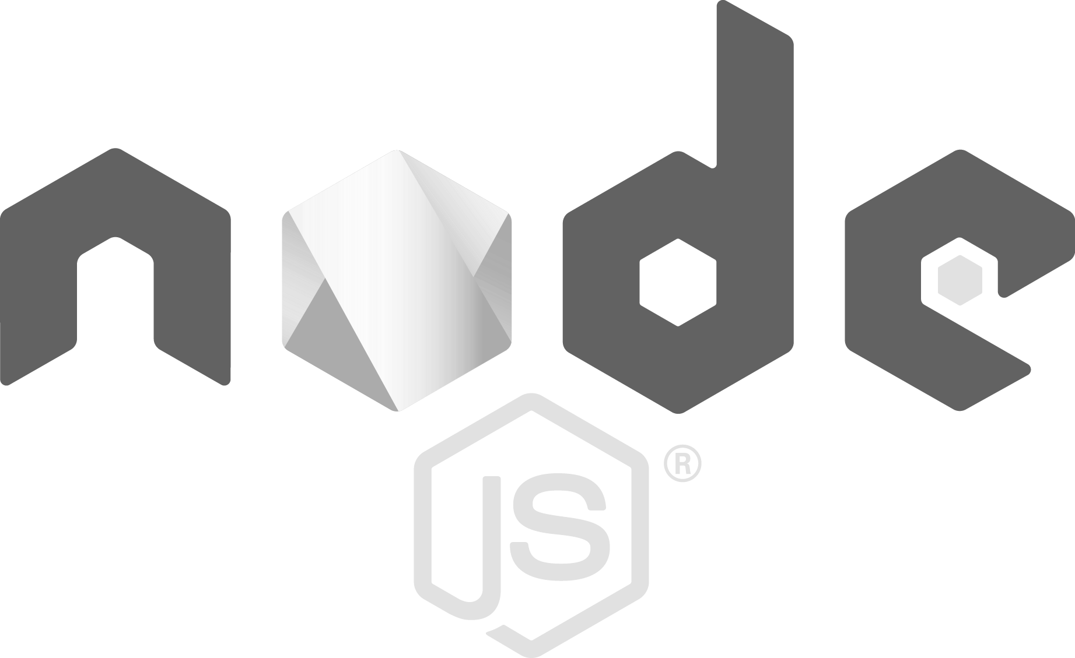
MySQL, PostgreSQL and MariaDB
Additional relational options in Azure
Managed community MySQL, PostgreSQL, and MariaDB
Languages and frameworks of your choice
Scale in seconds with built-in high availability
Secure and compliant
Industry-leading global reach
My
aka.ms/princeton-azure/dataintro​
Notes:
Azure Database for MySQL provides fully managed enterprise ready community MySQL database as a service for service for app development and deployment. Being community MySQL allows you to easily lift and shift to the cloud and use languages and frameworks for your choice. On top of that you get built-in high availability and capability to scale in seconds, helping you easily adjust to changes in customer demands. Additionally, you benefit from the unparalleled security and compliance, including Azure IP advantage, as well as Azure’s industry leading reach with more datacenters than any other cloud provider. All this with a flexible pricing model so you can choose resources for your workload with no hidden cost.
Languages and Frameworks of your choice
Being based on the community-editions of MySQL, PostgreSQL and MariaDB mean you can use the existing development languages frameworks and tools you already use for your apps. In addition, Azure Database Services are deeply integrated with Azure Web Apps to provide a streamlined provisioning and management experience for common frameworks (like WordPress, Drupal, Joomla) and languages (PHP, Node.js, Ruby) to provide a best-in-class PaaS experience.
Scale in Seconds with built-in HA
Azure Database Services are built upon the same service fabric framework that has been powering SQL Database for years. Unlike an VM-based PaaS offering like AWS RDS, Azure Database Services do not have the overhead a full VM stack has (e.g.; Linux OS + DB). Running on in a secured container implementation (SQLPAL, a very light-weight SQL OS), Azure Database Services can provision a new server in seconds in the event that a primary server hangs or crashes whereas in a traditional VM-based implementation the entire Linux (or Windows) OS stack has to bootstrap before the DB service loads. This means the entire experience of a failover can happen in as little as 30-45 seconds – and most importantly WITHOUT the need for a replica. AWS RDS requires deployment in Multi-AZ in order to achieve 99.95% SLA, which doubles your costs as you have 2 DB servers running at all times. With Azure Database Services, no replicas are needed which means no additional cost, or maintenance, by the customer.
Additionally, this HA infrastructure enables the ability for Azure Database Services to scale performance on the fly. When a customer needs to scale-up for workload spikes, by simply changing a slider in the portal, a new server is provisioned at a higher performance level and the previous server’s DNS name and storage is connected to the new instance. Scaling can take a little time as 20 seconds meaning customers can scale performance, up or down, with little/no downtime to the application.
Secure and Compliant
“Secure by default” is the standard for any Azure service, meaning elements such as SSL encryption between the database and application are turned on by default. Additionally, all data at-rest is encrypted by default in Azure storage using AES 256 bit encryption. And since Azure Database Services are using OSS database engines, the Azure IP Advantage means that customers do not have to worry about litigation using an OSS product in Azure. Microsoft provides indemnification for any OSS first party workload in Azure.
Industry-leading global reach
With more regions across the globe than any other public cloud provider, Azure offers the ability to have the most globally distributed MySQL, PostgreSQL or MariaDB-based application in the world.

Slide 14
Relational Data in Azure Fast Facts
Azure SQL
Uses the SQL Server engine
Can turn on built in alerts
Want the upcoming Machine learning services? Use SQL Server on a VM on Azure for now. There is a deployment option for this.
Additional Relational Options: PostgreSQL, MySQL, MariaDB
Not as many features as Azure SQL, but still get security and high availability
Use the tools you love
aka.ms/princeton-azure/dataintro​

Slide 15

Non-Relational/NoSQL
aka.ms/princeton-azure/dataintro​

Slide 16

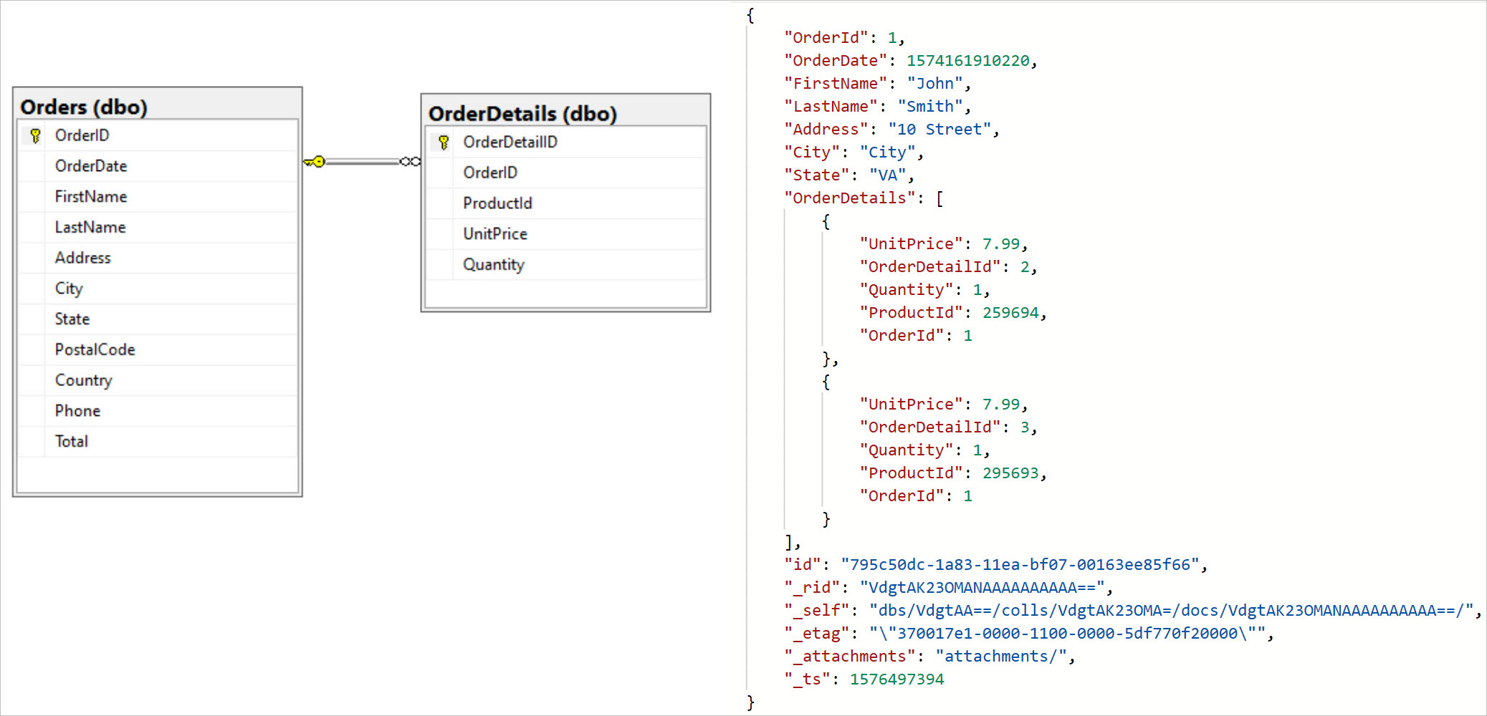
Example of NoSQL
aka.ms/princeton-azure/dataintro​

Slide 17
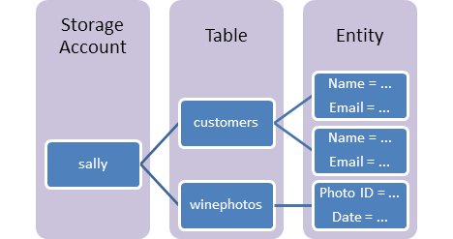
Table Storage
Part of an Azure Storage Account
Key/Value store
Accessible via REST
Schemaless
Entities can be up to 1 MB
aka.ms/princeton-azure/dataintro​

Slide 18





Cosmos DB
Core (SQL) API
Table API
MongoDB
Column-family
Document
Key-value
Graph
Guaranteed low latency at the 99th percentile
Elastic scale out
of storage & throughput
Five well-defined consistency models
Turnkey global distribution
Comprehensive SLAs
aka.ms/princeton-azure/dataintro​
Notes:
One of Cosmos DB’s main features is the large number of options in how you want to work with your non-relational data
SQL API
Azure Cosmos DB has native support for SQL and JavaScript APIs.
MongoDB API
Use Azure Cosmos DB as a fully managed database service for your MongoDB app, without any code changes, with native API support for MongoDB.
Table API
Use Azure Cosmos DB as a globally distributed database for your Azure Table storage-based application, without any code changes, using the Table API. You get secondary indexes, global distribution, policy-based failover capabilities, and much more.
Cassandra API
Deliver Cassandra as-a-service over the power of Azure Cosmos DB. Use Cassandra SDKs and tools to build applications at near-infinite global scale with SLA-backed capabilities of the Azure Cosmos DB platform.
Spark
For real-time machine learning over globally distributed datasets managed by Azure Cosmos DB, use the Spark connector to issue Apache Spark queries. The Spark connector takes advantage of native indexes managed by Azure Cosmos DB, resulting in significant performance gains.
Gremlin API
Take advantage of native Graph APIs on Azure Cosmos DB without any code changes, and issue globally distributed graph queries using Gremlin with Graph API.

Slide 19
Table Storage vs Cosmos DB
Table Storage
Cosmos DB
"I want to pay for the space my tables take up, not the throughput"
"My data isn't too critical"
"Latency isn't too much of a big deal for me"
"We experience a lot of traffic spikes"
"Lots of people are using this data"
"I want to use the integrated Spark notebooks features with my data"
aka.ms/princeton-azure/dataintro​

Slide 20
Non-Relational Data in Azure Fast Facts
Table Storage
Part of the Azure Storage account
Simple key value store that can store up to petabytes of data (if sharded)
NOT as powerful as Cosmos DB, not recommended for critical systems
Cosmos DB
"Multi-model" DB – choose your API
Proficient at scaling
Easy integration with Spark and Azure notebooks, just enable it
"Global distribution" - lets you put your data where it's being used the most
Result of this is low latency = data gets to end users faster
aka.ms/princeton-azure/dataintro​

Slide 21
Unstructured Data
aka.ms/princeton-azure/dataintro​

Slide 22



The Azure Storage Account
Blobs
Files
Queues
Tables
Disks
Object storage
access via REST
File storage
access via SMB, REST
Reliable messaging
access via REST
NOSQL storage
access via REST
IaaS VM VHD/ disks
access via REST
Streaming & random object access scenarios
Lift & shift scenarios
Scheduling async tasks
Key / Value Store
Persistent disks for VMs
Built on a unified and distributed storage system
Durability, encryption at rest, strongly consistent replication, fault tolerance, auto load-balancing
aka.ms/princeton-azure/dataintro​

Slide 23
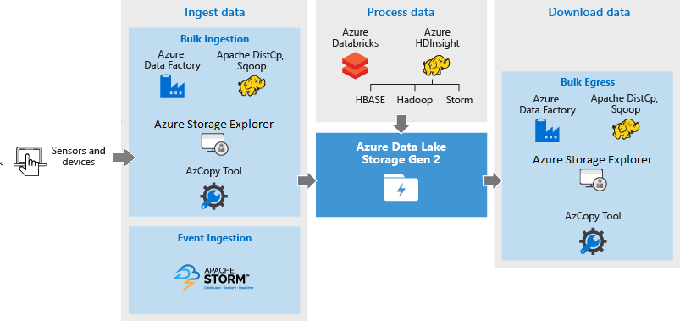
Data Lake
Part of the storage account, extension of Blob storage
Hierarchical File System: Easier to search
Open Source Integrations: HDInsight, Hadoop, Cloudera, Azure Databricks, Horntonworks
aka.ms/princeton-azure/dataintro​

Slide 24
Unstructured Data in Azure: Fast Facts
Storage Account
Accessible via REST
Multiple options under one service
Create a cross-platform file share with Files
Store different files with Blobs
Disks gives you multiple options for VMs
Queues are for messaging
Data Lake
Part of storage account
Ingest data from many sources, built into a hierarchical file system
Integration with open source platforms
aka.ms/princeton-azure/dataintro​

Slide 25
Additional Azure Services for Data
aka.ms/princeton-azure/dataintro​

Slide 26

Azure Data Factory
Transform & Analyze
MapReduce
BI & analytics
No SQL
Blob
Hive, Pig
VM
Store trusted data
Spark
DB
C#
Azure Machine learning
Stored Procedure
Ingest
Hybrid data integration at a global scale
Create, schedule, and monitor data pipelines
Fully managed ETL service in the cloud
Accelerate your data integration with multiple native connectors
aka.ms/princeton-azure/dataintro​

Slide 27
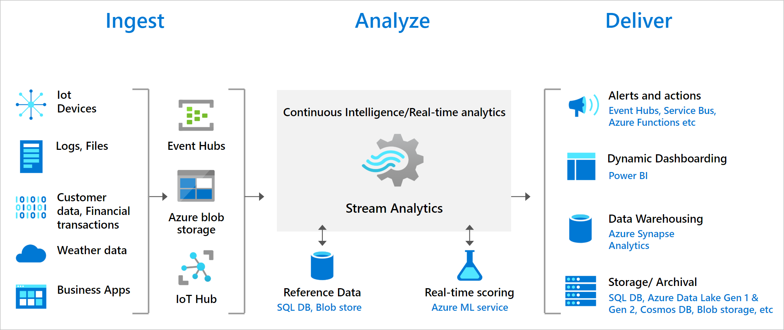
Azure Stream Analytics
aka.ms/princeton-azure/dataintro​

Slide 28
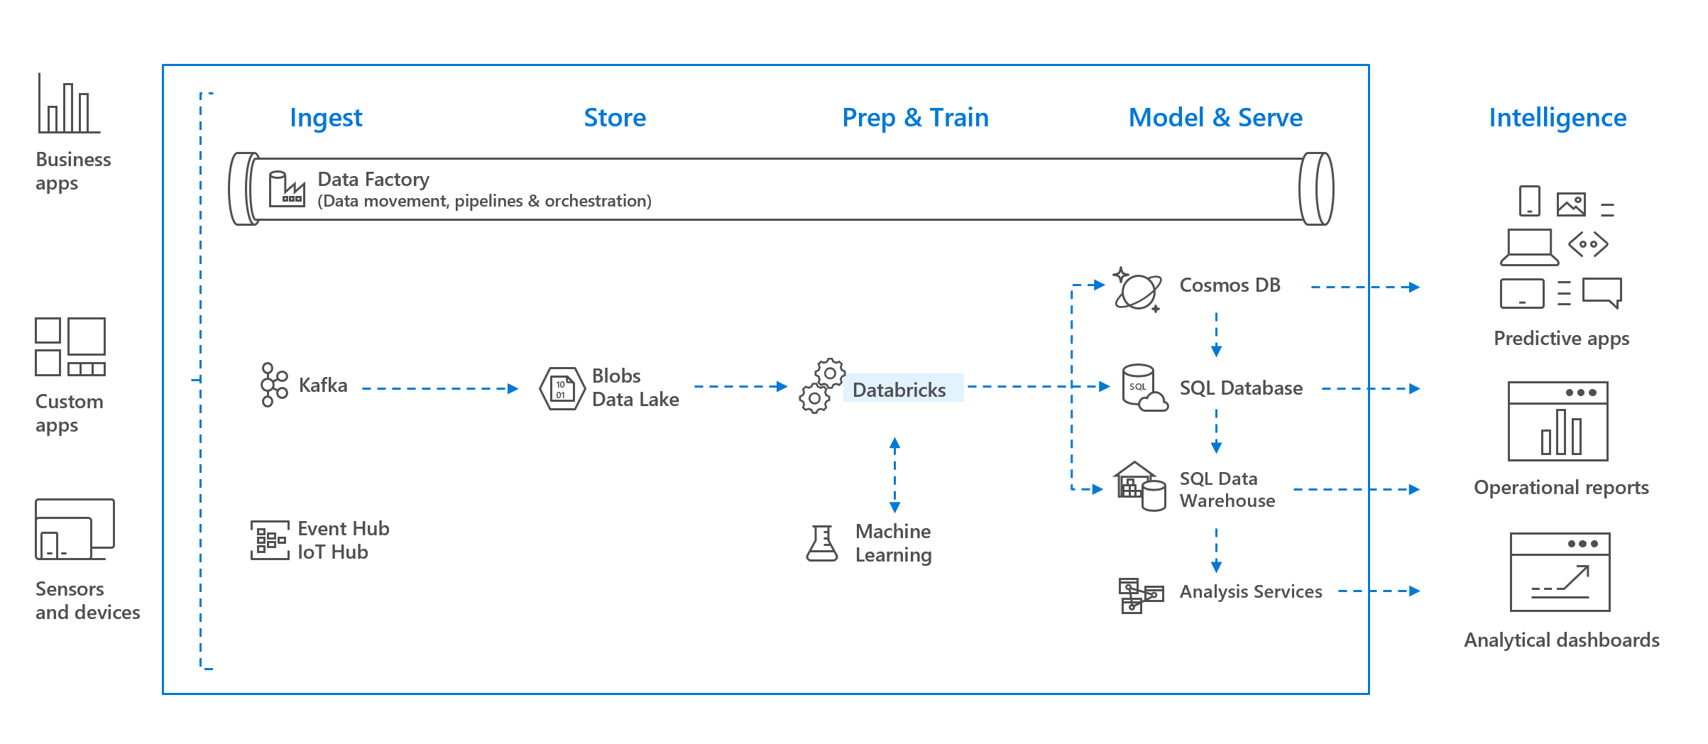
Azure Databricks
aka.ms/princeton-azure/dataintro​

Slide 29
Additional Data Services in Azure: Fast Facts
Data Factory
Code free ETL
Schedule ingestion and transforms on your data
Stream Analytics
Real time data ingestion and analysis from multiple sources
Scales to meet demand
Databricks
Optimized for Azure
Use your favorite Spark-based applications
aka.ms/princeton-azure/dataintro​

Slide 30
Where does my data fit in Azure?
aka.ms/princeton-azure/dataintro​

Slide 31
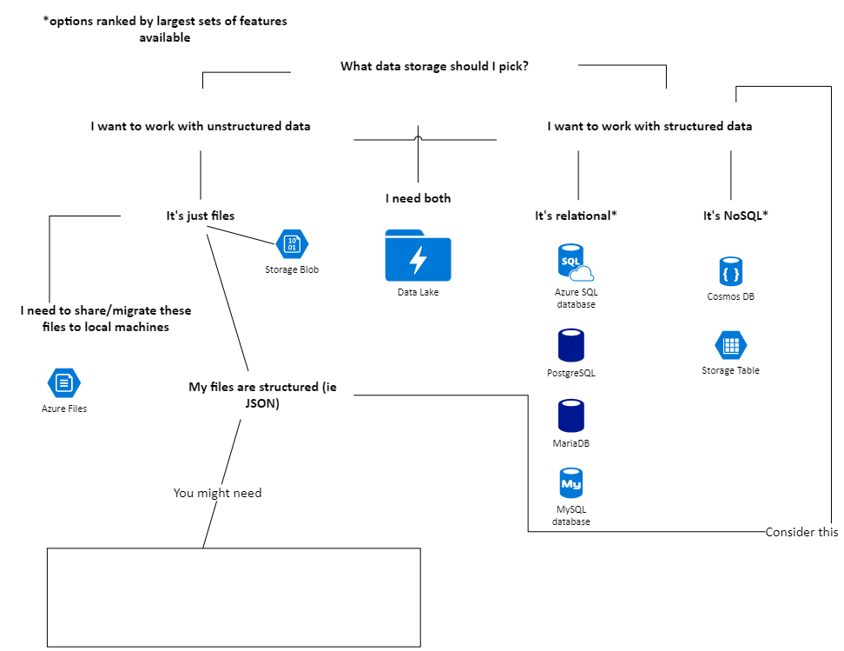

Your choice depends on your data
aka.ms/princeton-azure/dataintro​

Slide 32
Migrate: Moving Data to Azure?
Depending on your data, you'll most likely use either:
Database Migration Assistant
Common with Azure SQL and SQL Server
Database Migration Service
Common with large migrations
aka.ms/princeton-azure/dataintro​

Slide 33
What's in the resources?
Samples of this presentation's demonstrations
Short summary of this presentation
Info on where to go from here
Links to:
Microsoft Learn Modules
Documentation
aka.ms/princeton-azure/dataintro​

